Slide 1

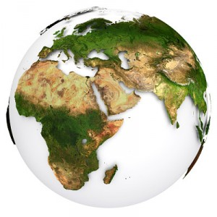
Africa
Exploring the Relationships between Characteristics of Poverty Probability

Slide 2


Introduction
My name is Kat Riddley, and I am a mother of three children, ages thirteen, sixteen, and eighteen.
My goal is to keep growing my character, personality, and fortitude because I believe success is something you attract by becoming the person you are meant to be.

Slide 3


About the Data
7 African countries
Poverty Probability Index
58 Features
12,600 individuals were surveyed
Age range: 15 yrs old – 115 yrs old
Presenter:
Katura Riddley

Slide 4
Project History
The most problematic issues in Africa:
1. Endless poverty 6. Ignorance of intellectual principles
2. Over-dependence on international aid 7. Inadequate science and
3. Lack of true leadership engineering education
4. The rich subaltern mindset 8. Poor understanding of the world
5. Endless conflicts 9. The so-called crab mentality
10. Media injustice
6

Slide 5
GDP 2020 - 21
Subregion | GDP (Nominal) (billions of $) |  |  | Share (%) |  | GDP (PPP) (billions of Int. $) | GDP (PPP) (billionsof Int. $) |  | Share(%) | Share(%)
 | 2020 | 2021 | Net Change | Africa | World | 2020 | 2021 | Net Change | Africa | World
Northern Africa | 718.272 | 792.127 | 73.855 | 29.42 | 0.83 | 2,404.996 | 2,625.613 | 220.617 | 36.53 | 1.82
Western Africa | 695.903 | 776.544 | 80.641 | 28.84 | 0.82 | 1,744.847 | 1,872.381 | 127.534 | 26.05 | 1.29
Eastern Africa | 419.041 | 442.790 | 23.749 | 16.44 | 0.47 | 1,112.283 | 1,194.220 | 81.937 | 16.62 | 0.83
Southern Africa | 367.098 | 452.128 | 85.030 | 16.79 | 0.48 | 868.118 | 944.540 | 76.422 | 13.14 | 0.65
Middle Africa | 186.389 | 216.480 | 30.091 | 8.04 | 0.23 | 497.601 | 523.636 | 26.035 | 7.29 | 0.36
Africa | 2,396.739 | 2,692.597 | 295.858 | -- | 2.84 | 6,653.013 | 7,187.546 | 534.533 | -- | 4.97
Africa’s GDP

Slide 6
Interesting Facts
Africa is by far the poorest continent on the planet
Half of the population lives in poverty
The economic gap is huge and still growing
Two out of five adults are illiterate
One out of four people in the sub-Saharan region are malnourished

Slide 7
Analysis Methods
Dataset Retrieved: Kaggle.com
Entries/columns: 12,600/59
Programming language: Python
Visualization: Tableau
Tools:
Pandas
Sklearn
Scipy
Seaborn
Statsmodel
Completed:
Data wrangling
Plotting variables
Logistic Regression
Predictions
Classifications
Variables Used/Python:
18 out of 59
Variables Used/Tableau:
Age
Country
Poverty Probability
Female/Male
Married/Unmarried
Education Level
Employed/Unemployed

Slide 8
Evaluation Questions
1. How does the relationship between characteristics effect poverty probability?
2. What is a possible solution that will help decrease the likelihood of poverty probability?

Slide 9
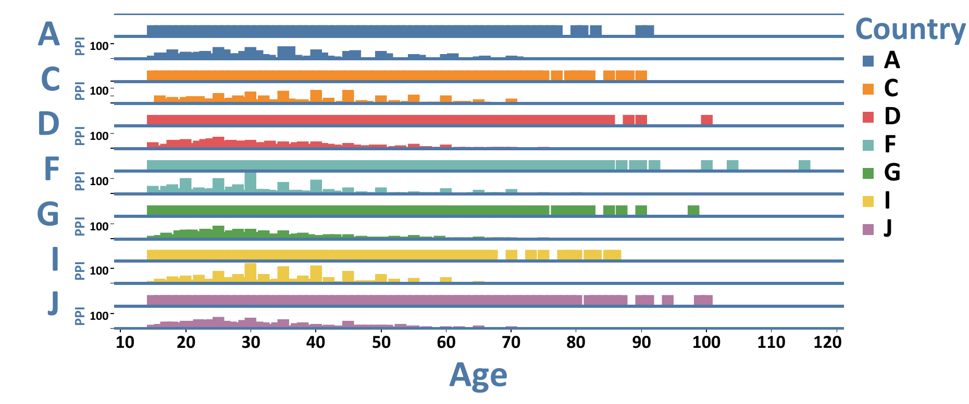
Results: Country and Age

Slide 10
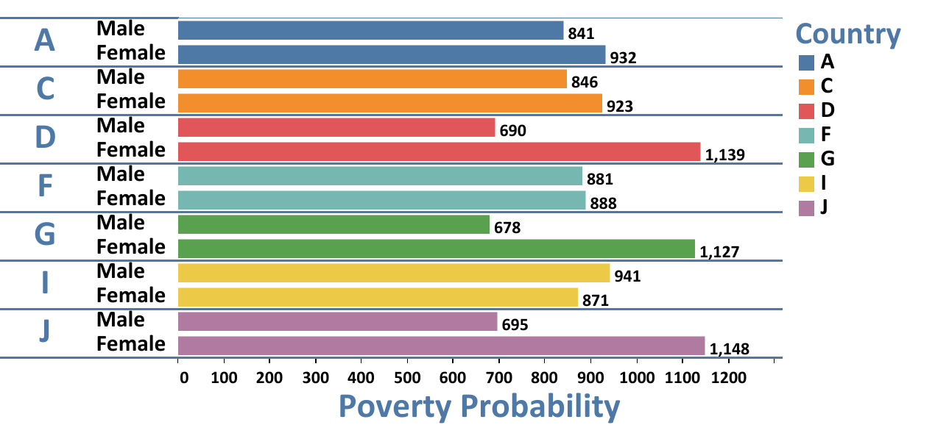
Results: Female Vs. Male

Slide 11
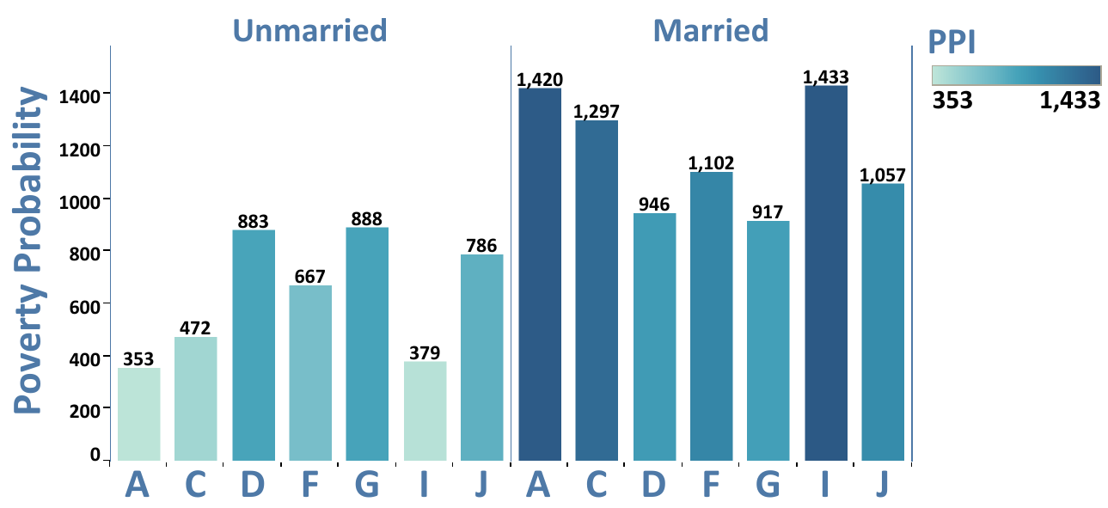
Results: Married Vs. Unmarried

Slide 12
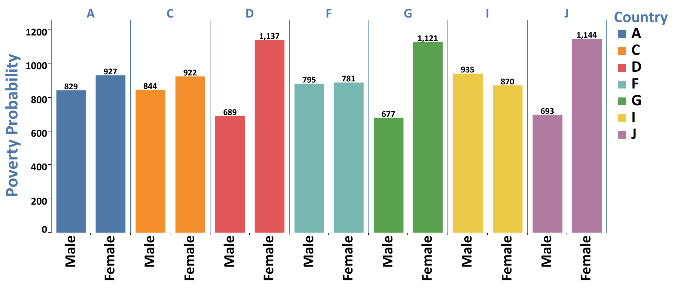
Results: Education Vs. M/F

Slide 13
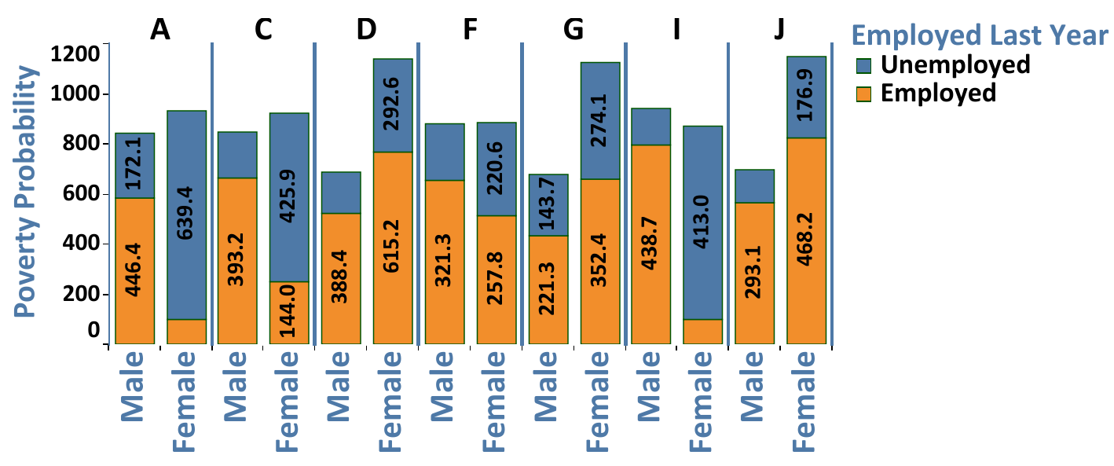
Results: Employment Vs. M/F

Slide 14
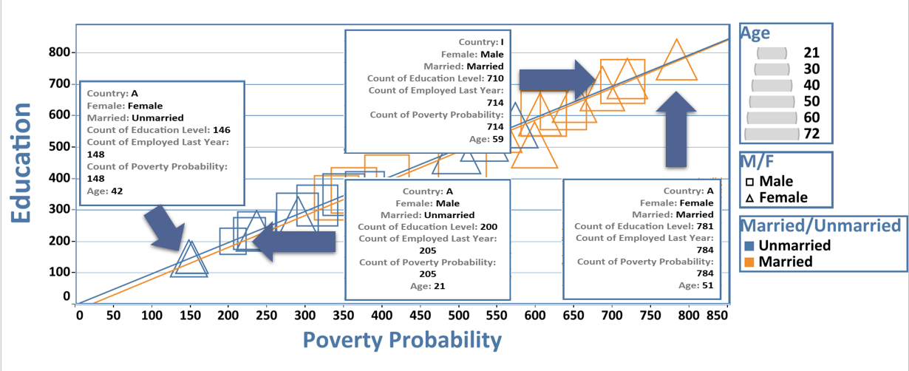
Results: All Variables

Slide 15
Summary
Variables:
Age
Country
Poverty Probability
Female/Male
Married/Unmarried
Education Level
Employed/Unemployed

Slide 16
Conclusion
Contributing factors of Poverty Probability:
Lack of Leadership
Inadequate Education
Diverse Employment Opportunities
Absence of Technology Resources
Poor Economy
Rapid Population Growth

Slide 17
Thank You!

Slide 18
Questions?

Slide 19
References
Africa GDP 2021 - StatisticsTimes.com
The rapid decline in Africa’s GDP - Tribune Online (tribuneonlineng.com)
15 Facts About Poverty in Africa That Everyone Should Know (borgenproject.org)
Top 10 Problems in Africa (answersafrica.com)
List of Countries by Continent - StatisticsTimes.com
Poverty Prediction: From Visualization to Stacking | Kaggle - Johnny Yiu - 2019
Economy of Africa - Wikipedia

